Slide 1
STEMI-INITIAL PRESENTATION TIMING 2013 ACC/AHA GUIDELINES
HIMAL RAJ M

Slide 2
Regional Systems of STEMI Care, Reperfusion Therapy, and Time-to-Treatment Goals: Recommendations- CLASS I
All communities should create and maintain a regional system of STEMI care that includes assessment and continuous quality improvement of EMS and hospital-based activities (LOE: B)
Performance of 12-lead ECG by EMS personnel at site of FMC is recommended in patients with symptoms consistent with STEMI (LOE : B)
Reperfusion therapy should be administered to all eligible patients with STEMI with symptom onset within the prior 12 hrs (LOE: A)
Primary PCI is the recommended method of reperfusion when it can be performed in a timely fashion by experienced operator (LOE: A)
EMS transport directly to a PCI-capable hospital for primary PCI is the recommended triage strategy for patients with STEMI, with an ideal FMC-to-device time system goal of 90 mins or less (LOE: B)

Slide 3
Immediate transfer to a PCI-capable hospital for primary PCI is the recommended triage strategy for patients with STEMI who initially arrive at or are transported to a non–PCI-capable hospital, with an FMC-to-device time system goal of 120 mins or less (LOE: B)
In the absence of contraindications, fibrinolytic therapy should be administered to patients with STEMI at non–PCI-capable hospitals when the anticipated FMC-to-device time at a PCI capable hospital exceeds 120 mins because of unavoidable delays (LOE: B)
When fibrinolytic therapy is indicated or chosen as the primary reperfusion strategy, it should be administered within 30 mins of hospital arrival (LOE: B)

Slide 4
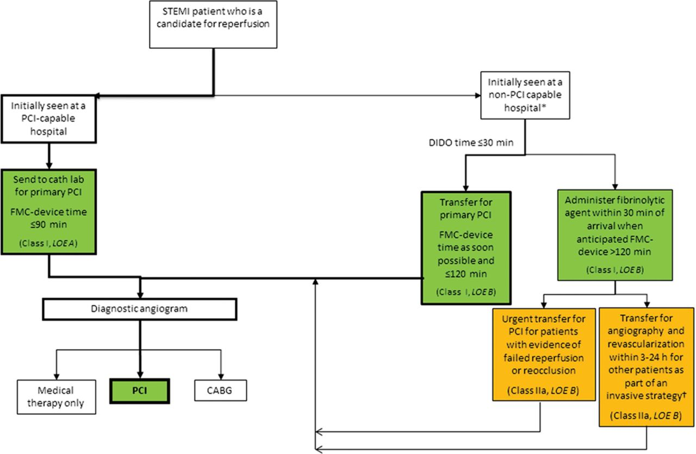
Reperfusion therapy for patients with STEMI. The bold arrows and boxes are the preferred strategies.
WRITING COMMITTEE MEMBERS* et al. Circulation. 2013;127:e362-e425
Copyright © American Heart Association, Inc. All rights reserved.
Notes:
Reperfusion therapy for patients with STEMI. The bold arrows and boxes are the preferred strategies. Performance of PCI is dictated by an anatomically appropriate culprit stenosis. *Patients with cardiogenic shock or severe heart failure initially seen at a non–PCI-capable hospital should be transferred for cardiac catheterization and revascularization as soon as possible, irrespective of time delay from MI onset (Class I, LOE: B). †Angiography and revascularization should not be performed within the first 2 to 3 hours after administration of fibrinolytic therapy. CABG indicates coronary artery bypass graft; DIDO, door-in–door- out, FMC, first medical contact; LOE, Level of Evidence; MI, myocardial infarction; PCI, percutaneous coronary intervention; and STEMI, ST-elevation myocardial infarction.

Slide 5
CLASS IIa
Reperfusion therapy is reasonable for patients with STEMI and symptom onset within the prior 12 to 24 hrs who have clinical and/or ECG evidence of ongoing ischemia. Primary PCI is the preferred strategy in this population (LOE: B)

Slide 6
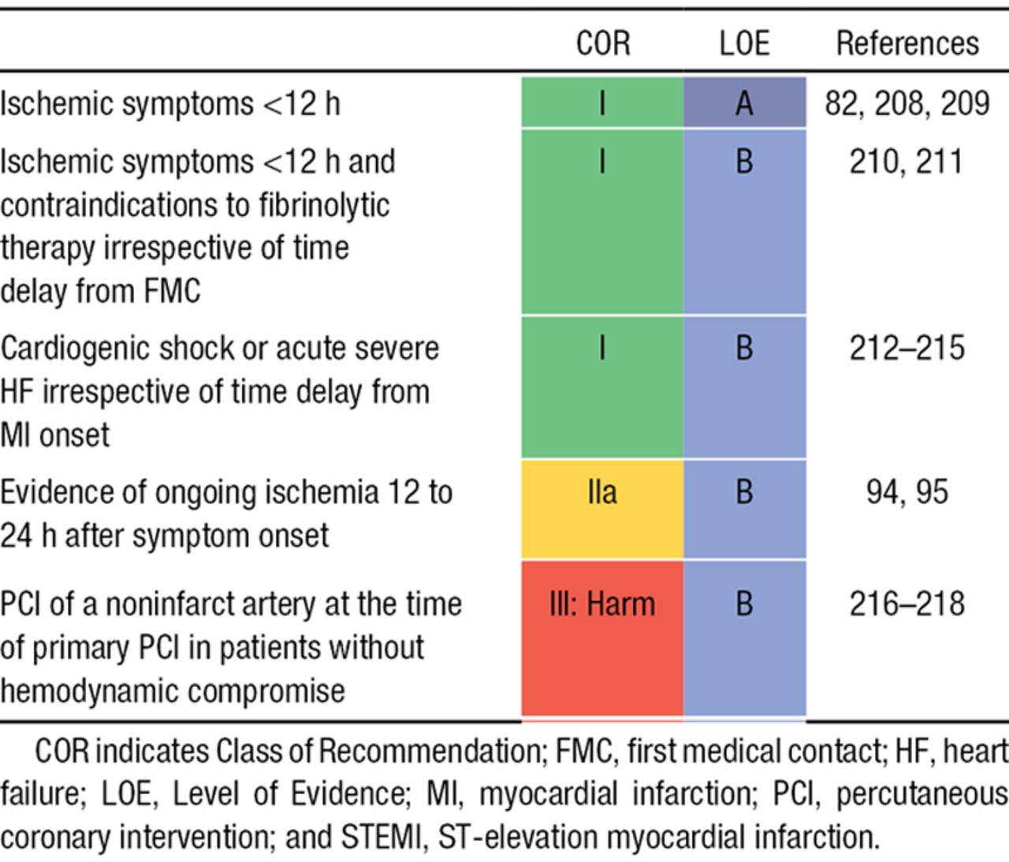
Primary PCI in STEMI.
WRITING COMMITTEE MEMBERS* et al. Circulation. 2013;127:e362-e425
Copyright © American Heart Association, Inc. All rights reserved.
Notes:
Primary PCI in STEMI

